Slide 1
STUDENT PERFORMANCE
ANALYSIS DASHBOARD
Power BI Project Presentation
Dashboard Screenshots • Insights • Performance Factors
Presented by: Ronak Patel
Enrollment No.: 250393107011
S.P.B. Patel Engineering College

Slide 2
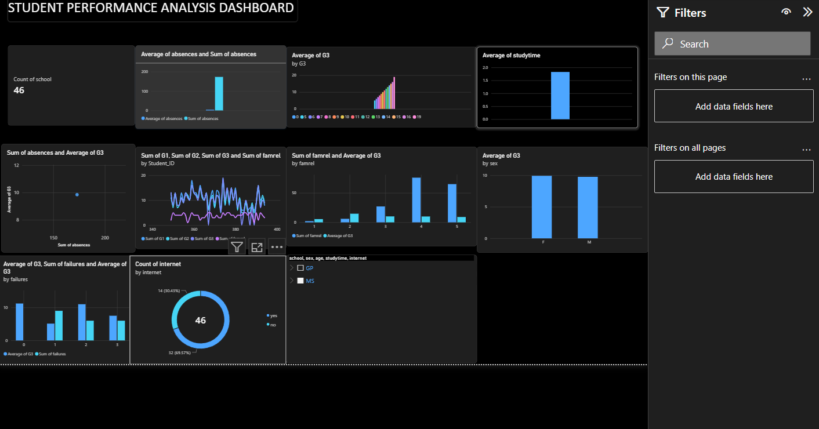
Dashboard Page 1 — Student Performance Overview
Overview of student count, absences, grades, study time, failures, internet access and student categories.
Ronak Patel | Enrollment No. 250393107011 | S.P.B. Patel Engineering College

Slide 3
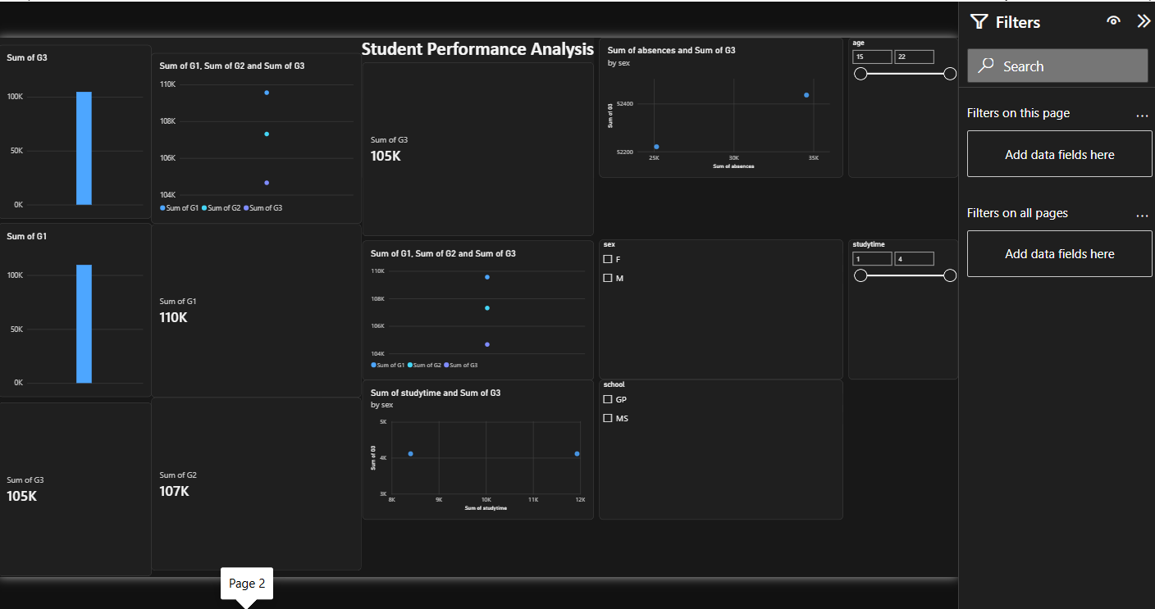
Dashboard Page 2 — Performance Summary
Summary of G1, G2 and G3 grades with age, sex, school and study-time filters.
Ronak Patel | Enrollment No. 250393107011 | S.P.B. Patel Engineering College

Slide 4
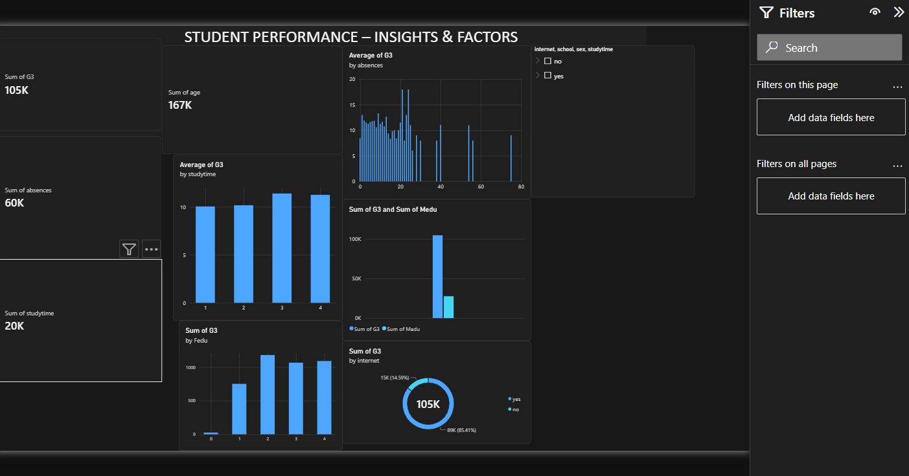
Dashboard Page 3 — Insights & Factors
Insights into grade patterns by absences, study time, education and internet access.
Ronak Patel | Enrollment No. 250393107011 | S.P.B. Patel Engineering College

Slide 5
Problem Statement
Why analyze student performance?
• Student results can vary due to attendance, study time, past grades and other factors.
• Raw tables make it difficult to identify trends quickly.
• A Power BI dashboard converts student records into interactive visual summaries.
• The project aims to support clearer, data-informed academic decisions.
Ronak Patel | Enrollment No. 250393107011 | S.P.B. Patel Engineering College
STUDENT PERFORMANCE ANALYSIS | 05

Slide 6
Project Objectives
What this dashboard is designed to do
• Summarize student performance using grade fields such as G1, G2 and G3.
• Compare outcomes by study time, absences, sex, school and internet access.
• Provide filters so users can explore selected student groups.
• Present key information through cards, bar charts, line charts and a donut chart.
• Make the dashboard easier to explain during a project presentation.
Ronak Patel | Enrollment No. 250393107011 | S.P.B. Patel Engineering College
STUDENT PERFORMANCE ANALYSIS | 06

Slide 7
Dataset Overview
Main fields used in the student performance analysis
G1, G2, G3
Grades / performance measures
absences
Number of absences
studytime
Study-time category
failures
Past class failures
sex, school
Student and school categories
internet
Internet access at home
age
Student age
Ronak Patel | Enrollment No. 250393107011 | S.P.B. Patel Engineering College
STUDENT PERFORMANCE ANALYSIS | 07

Slide 8
Dashboard Components
How the visuals help explain the data
KPI Cards
Show summary values such as student count or total grades.
Bar Charts
Compare grades and other measures across categories.
Line / Scatter Charts
Explore relationships and patterns between measures.
Donut Chart
Show the split between categories such as internet access.
Slicers & Filters
Narrow the analysis by school, sex, age or study time.
Ronak Patel | Enrollment No. 250393107011 | S.P.B. Patel Engineering College
STUDENT PERFORMANCE ANALYSIS | 08

Slide 9
Key Insights to Discuss
Use the charts to explore possible patterns—not to assume causation
• Compare G1, G2 and G3 to see how performance changes across grading periods.
• Check whether higher study-time categories show different average G3 values.
• Explore how absences and previous failures relate to final grades.
• Use school, sex and internet-access filters to compare groups fairly.
• Validate findings against the underlying dataset before making conclusions.
Ronak Patel | Enrollment No. 250393107011 | S.P.B. Patel Engineering College
STUDENT PERFORMANCE ANALYSIS | 09

Slide 10
Recommendations & Conclusion
Turning dashboard observations into practical next steps
• Identify students who may need support using grades, attendance and failure history together.
• Encourage consistent study routines and regular attendance.
• Use filters to investigate groups, then verify the results with teachers or academic staff.
• Keep the dataset clean and update it regularly so the dashboard remains useful.
• Conclusion: Power BI makes student data easier to explore, compare and communicate.
Ronak Patel | Enrollment No. 250393107011 | S.P.B. Patel Engineering College
STUDENT PERFORMANCE ANALYSIS | 10

